Slide 1

ISLAMIC CORPORATION FOR THE DEVELOPMENT OF THE PRIVATE SECTOR
Website UI/UX Analysis and Bug report.

Slide 2
UI/UX Analysis

Slide 3
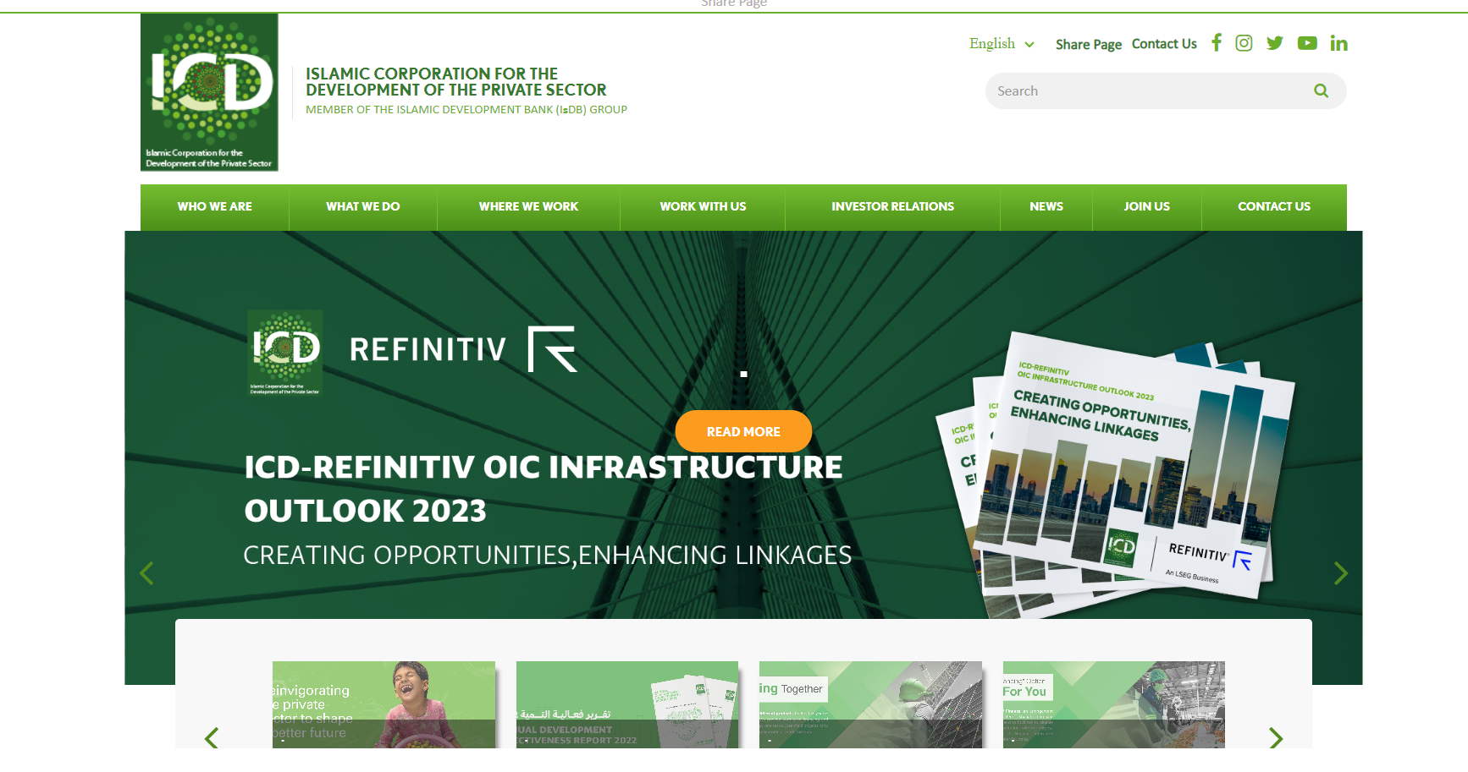
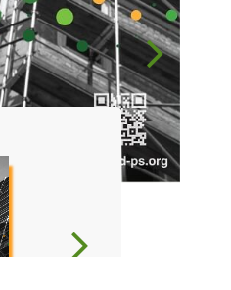

Main Navigation & Slider
Sticky bar
Contact Us (CTA)
Navigation bar
Finding
Header size is too big.
Share page (CTA) and contact us (CTA) are repeated twice.
There is a sticky bar just for share page (CTA).
The Navigation bar design is outdated.
The slider design is not user friendly.
Read more (CTA) button position is not placed correctly.
There is a dot above of the (CTA) button.
There are two slider navigation. Which makes it not user friendly for the user.
Slider Navigation
The dot
Solution
Redesign for all section
Read More (CTA) Button

Slide 4
Design and Layout
Finding
A lot of white spaces in all pages.
In some sections photo grids and size is not consistent.
The social feeds section on the home page needs to be organized better.
On some pages, the title has a background color. This needs to be removed.
The footer needs to improve to make it easy for user to navigate around the website.
Solution
Unify the mentioned elements across the website and modernize the outdated ones.
The website doesn’t contain any icons which can represent the services instead of listing it.

Slide 5
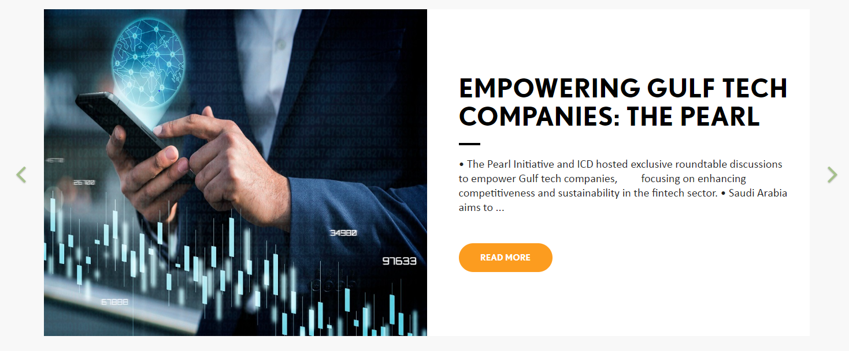
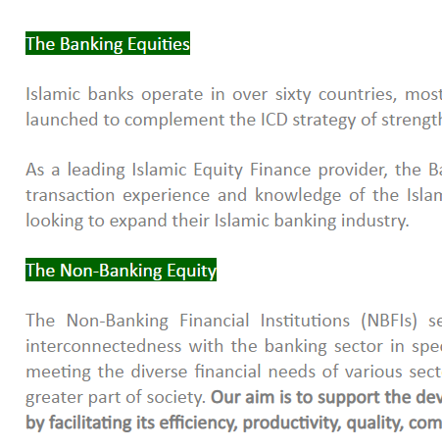
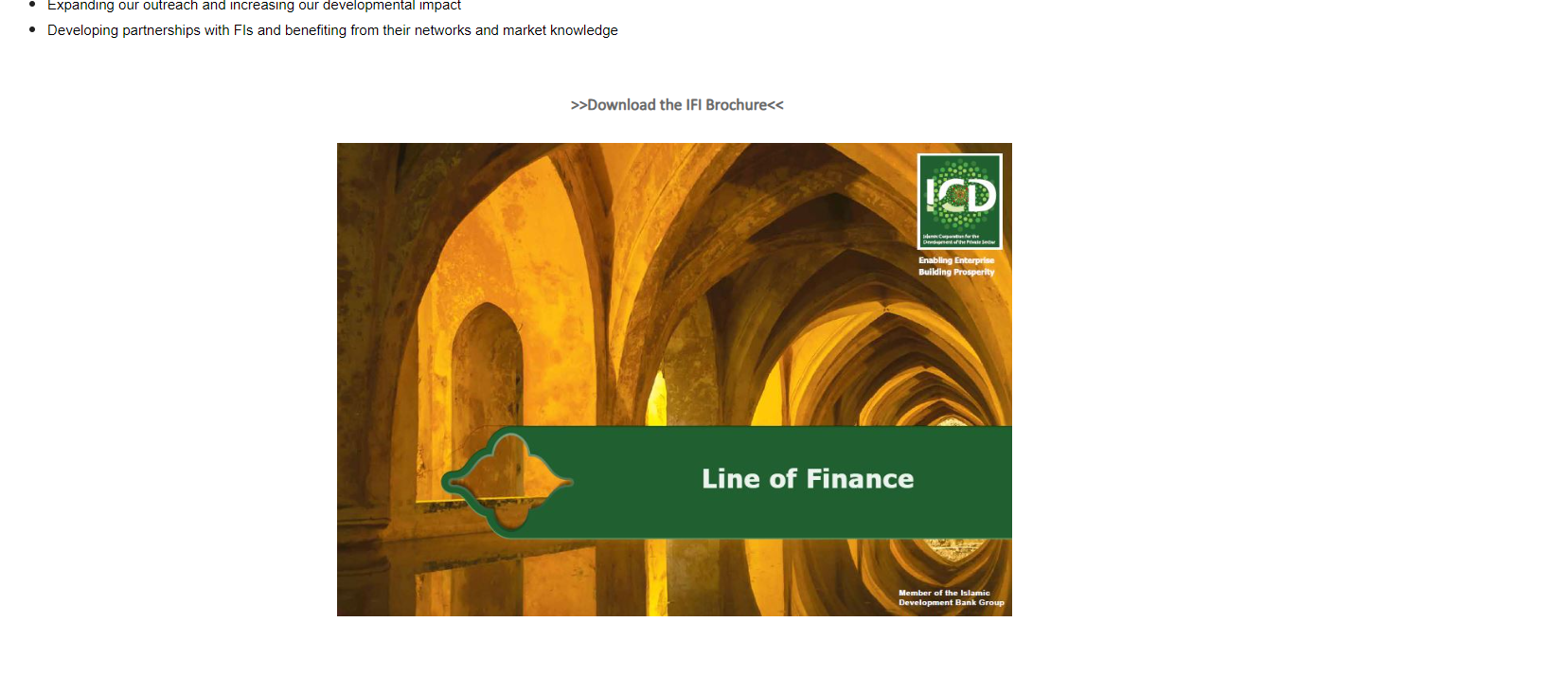
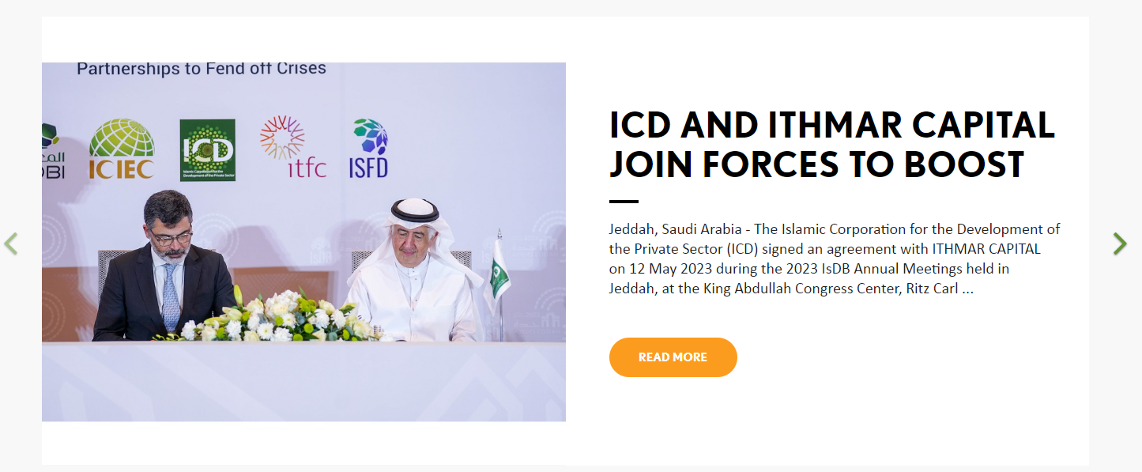
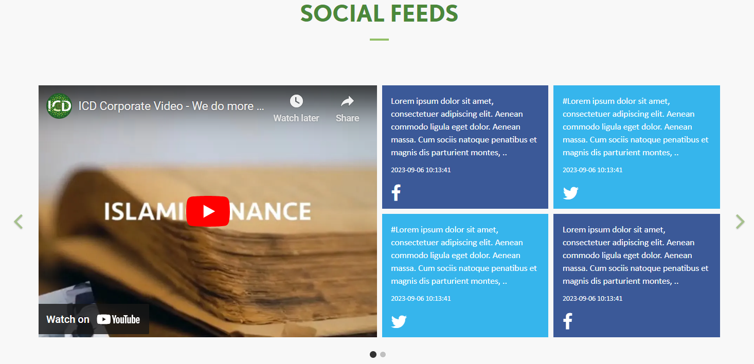
Design and Layout
Different photo size
White spaces
Title has a background color
Footer

Slide 6
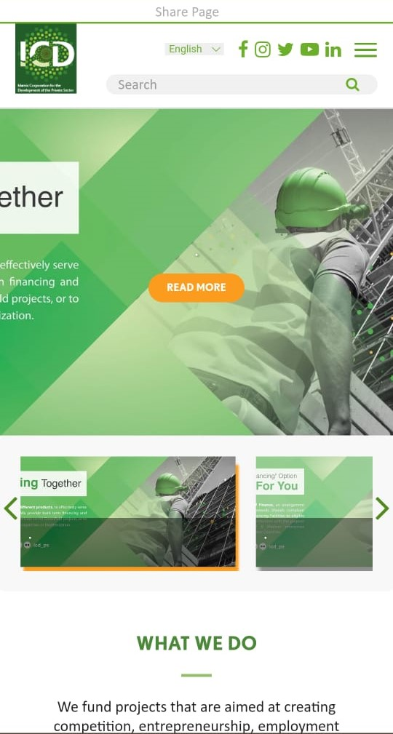
Website Responsiveness
Finding
The current website needs to be more responsive when opened on different devices like mobile phones or tablets, which means the sizing of elements, general layout and proportions of the website should be optimized to automatically adapt to different screen sizes and be properly displayed on any device.
Avoid overlapping the images on the mobile devices.
Banner slider photo size needs to minimized.

Slide 7
Bug report

Slide 8
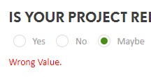
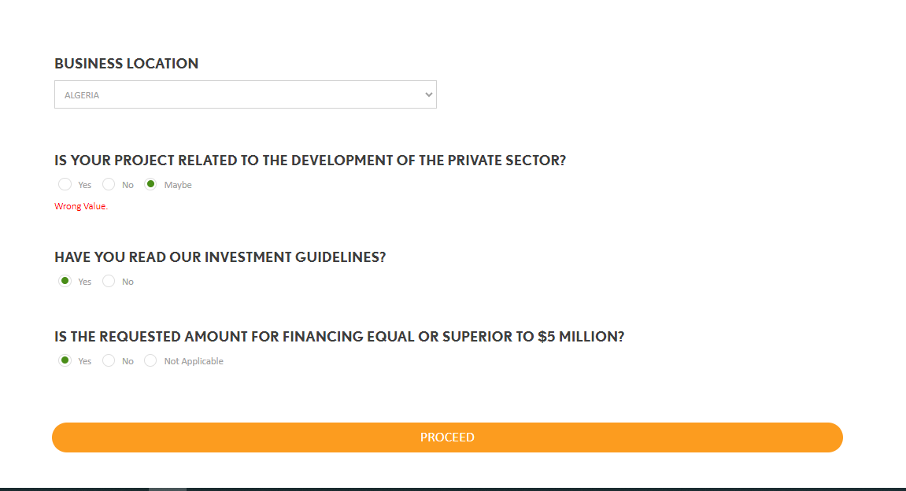
Why does clicking maybe give me wrong value?
Severity: LOW Priority: LOW Environment:
core I 5
google chrome
Finding
On the application page, when I click on maybe, wrong value is displayed on the screen
Steps:
Open website
Click on WORK WITH US from the navigation bar
Then click on application then scroll down to the form
Expected Results:
Maybe not a wrong value
Actual Results:
Wrong value displayed on the screen when I select it

Slide 9
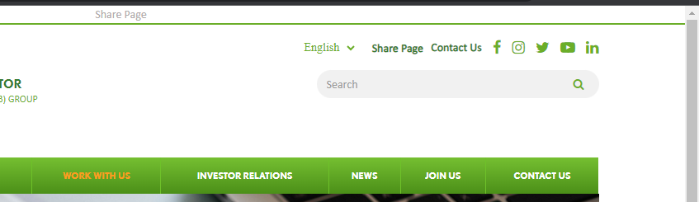
The share Page link is not working
Finding
The share Page(call to action ) link not working
Steps:
Open website
Click on share Page link
Expected Results:
Navigate to share page link
Actual Results:
The share Page link not working
Severity: High Priority: high Environment:
core I 5
google chrome

Slide 10
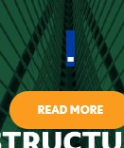
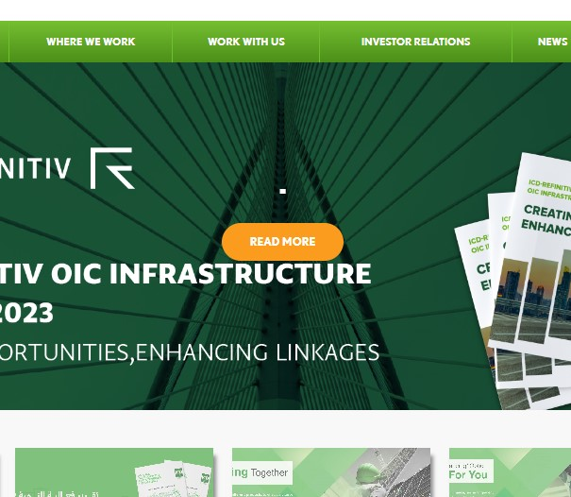
The (Read More) button needs to be re-positioned, and The dot needs to be removed
Severity: medium Priority: medium Environment:
core I 5
Google Chrome
Finding
Read More button needs to be re-position and the dot needs to be removed
Steps:
Open website
Scroll down to banner

Slide 11
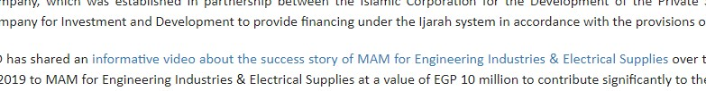
SUPPORTED BY ENMAA FINANCE AND THE ISLAMIC CORPORATION FOR THE DEVELOPMENT OF THE PRIVATE SECTOR, MAM FOR ENGINEERING INDUSTRIES & ELECTRICAL SUPPLIES ACHIEVES GROWTH.
The latest news page
Finding
The YouTube link on this page opens in the same tab
Steps:
Open website
Scroll down to the latest news section
Click to read more
Scroll down in details page
Click on YouTube link
Expected Results:
YouTube link opens in a new tab
Actual Results:
Link open in the same tap
Severity: medium Priority: medium Environment:
core I 5
Google Chrome

Slide 12
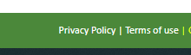
Missing Arabic and French content
Finding
missing Arabic and French content in terms of use page and privacy policy
Steps:
Open website
Scroll down to the bottom
Click on the terms of use page
Click on privacy policy
Expected Results:
Arabic content must exist
Actual Results:
Missing Arabic and French content
Severity: medium Priority: medium Environment:
core I 5
Google Chrome

Slide 13
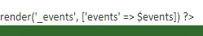
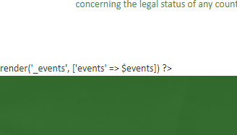
Line code display on frontend
Finding
render('_events', ['events' => $events]) ?>
This code appears in frontend in home page
Steps:
Open website
Scroll down in the homepage
Stop in MEMBER COUNTRIES section
Expected Results:
This code does not display on the screen
Actual Results:
This code appears in frontend
Severity: critical Priority: critical Environment:
core I 5
Google Chrome

Slide 14
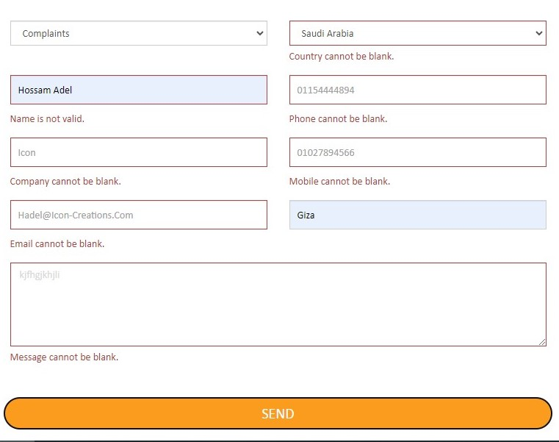
Contact us form not working
Steps:
Open website
Click on the Contact Us page
Fill all boxes with valid data
Click on send button
Form not working
Severity: Critical Priority: critical Environment:
core I 5
Google Chrome

Slide 15
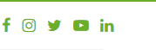
Social media links open in the same tap
Finding
When I click on social media links, open in the same browser tap
Steps:
Open website
Click on social media links
Expected Results:
social media link opens in a new tab
Actual Results:
Links open in the same tap
Severity: medium Priority: medium Environment:
core I 5
Google Chrome

Slide 16
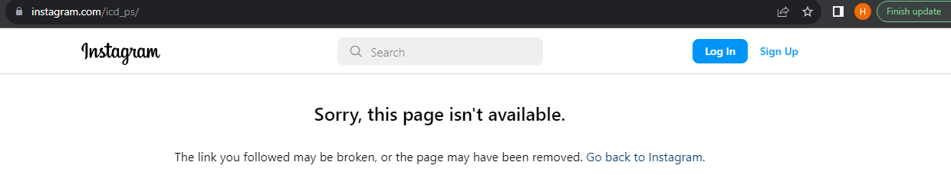
The Instagram link not working
Finding
The Instagram link not working
Steps:
Open website
Click on Instagram link
Severity: low Priority: low Environment:
core I 5
Google Chrome

Slide 17
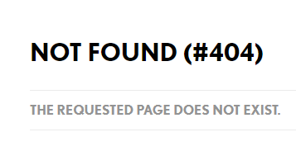

NOT FOUND (#404) https://icd-ps.org/en/institution-equity
Finding
Page not found
Steps:
Open website
Scroll down to the What We Do section
Click on the read more button
Expected Results:
Page work successfully
Actual Results:
Page not found
Severity: Critical Priority: critical Environment:
core I 5
Google Chrome

Slide 18
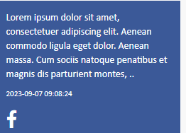
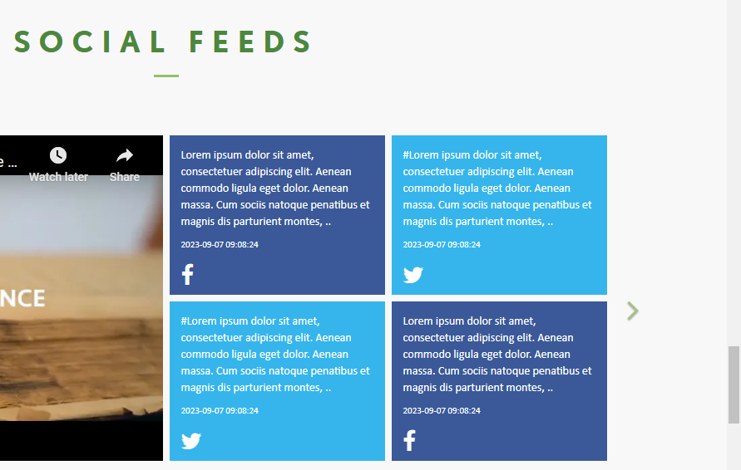
Invalid content in social feed section
Finding
Invalid content on the home page
Steps:
Open website
Scroll down to the social feeds section
Severity: medium Priority: medium Environment:
core I 5
Google Chrome

Slide 19
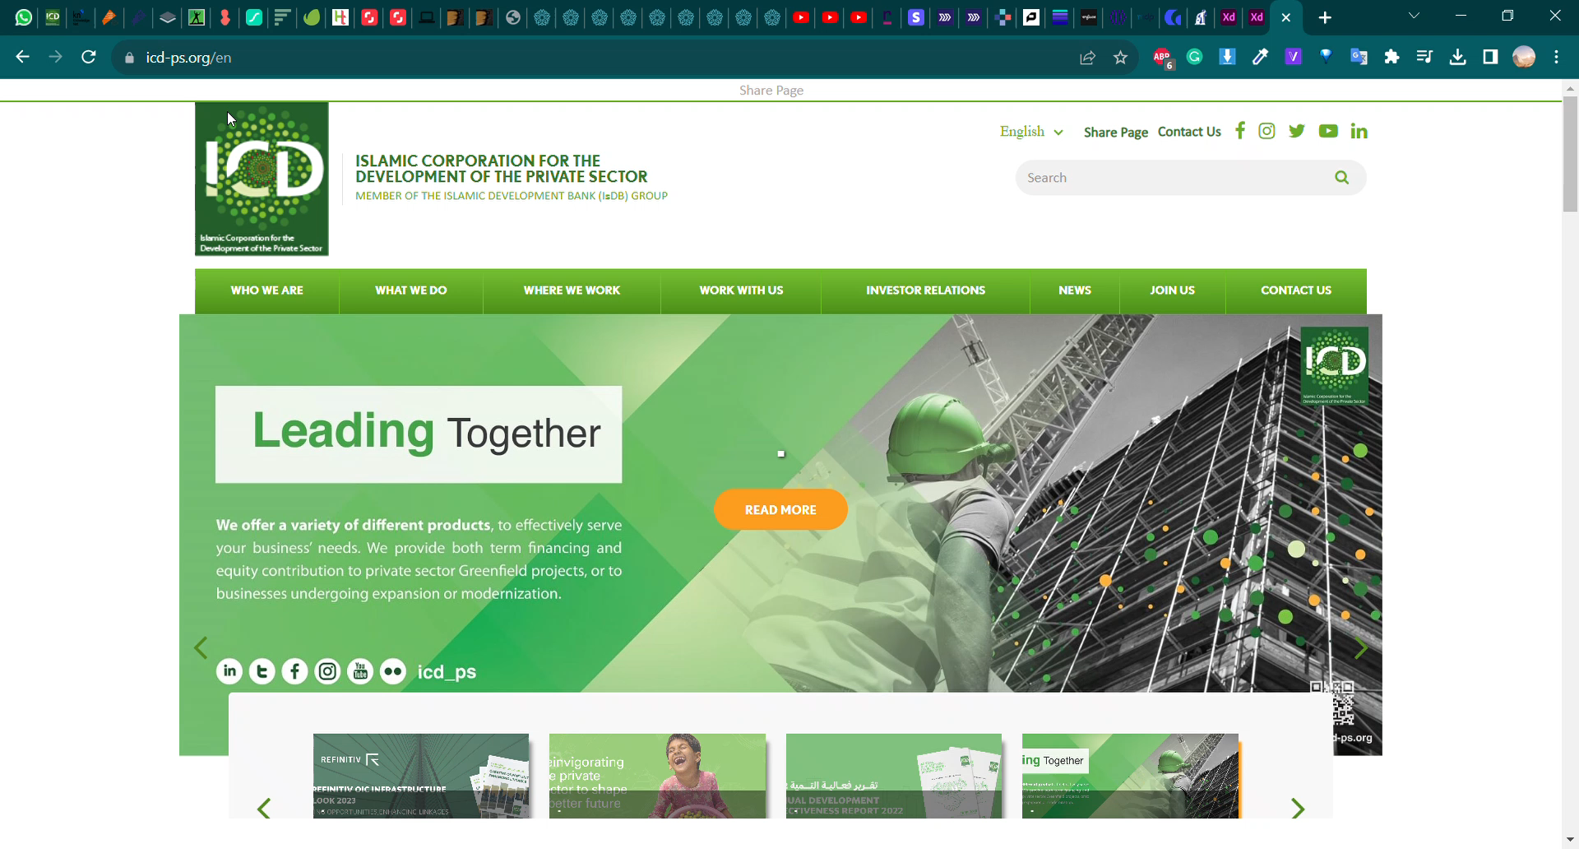
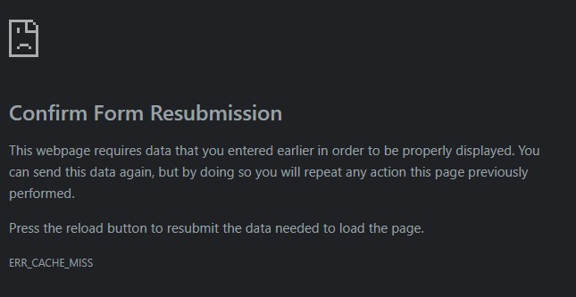
Confirm Form Resubmission
Severity: Critical Priority: critical Environment:
core I 5
Google Chrome
Finding
When I make a search then go to the result page. I click on the result and then go back to the page before the video below pops up.
Steps
Open website
Search about the projects
Click on the result link
Click on the back button

Slide 20

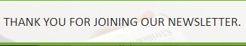
Newsletter form accepts invalid email
Finding
Newsletter form accepts invalid email
Steps:
Open website
Click on the PRESS RELEASE from the nav bar
Scroll down to the newsletter form
Enter invalid email
Expected Results:
Subscribe failed
Actual Results:
Thank you
Severity: High Priority: high Environment:
core I 5
google chrome

Slide 21
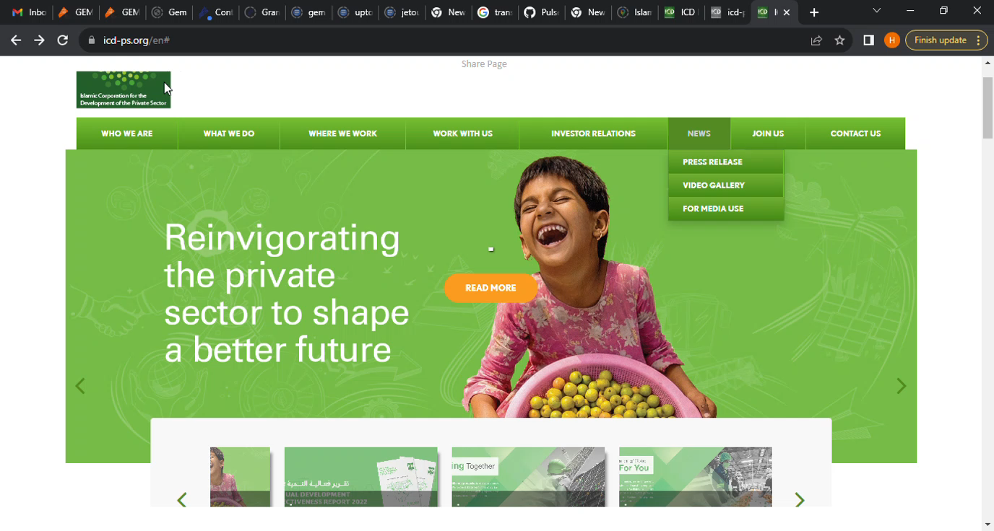
Press Release Page
Finding:
Press Release details sends me to the Home Page.
Steps:
After clicking on the news button. It shows me the yearly press releases. I click read more, it shows me more details. After clicking back, it sends me to the home page. It should not do that, it should send me to the press release page. As displayed in the video below.
Expected Results:
When I click on the back button shows me press releases
Actual Results:
Go to the home page when I click on back
Severity: High Priority: high Environment:
core I 5
google chrome

Slide 22
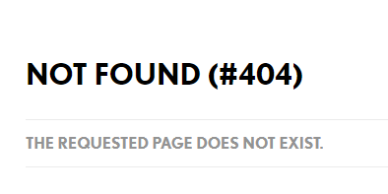
NOT FOUND (#404) in AT A GLANCE page
Finding
Page not found
Steps:
Open website
Click on at a glance page from the nav bar
Scroll down to what we do section
Click on View Projects button
Page not found
Expected Results:
Page work successfully
Actual Results:
Page not found
Severity: Critical Priority: critical Environment:
core I 5
Google Chrome

